Slide 1
Curvature & Normal Vectors

Slide 2
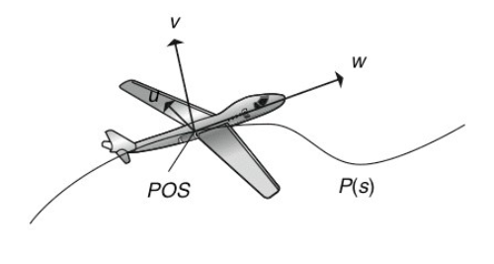
Frenet Frames in Flight Dynamics

Slide 3
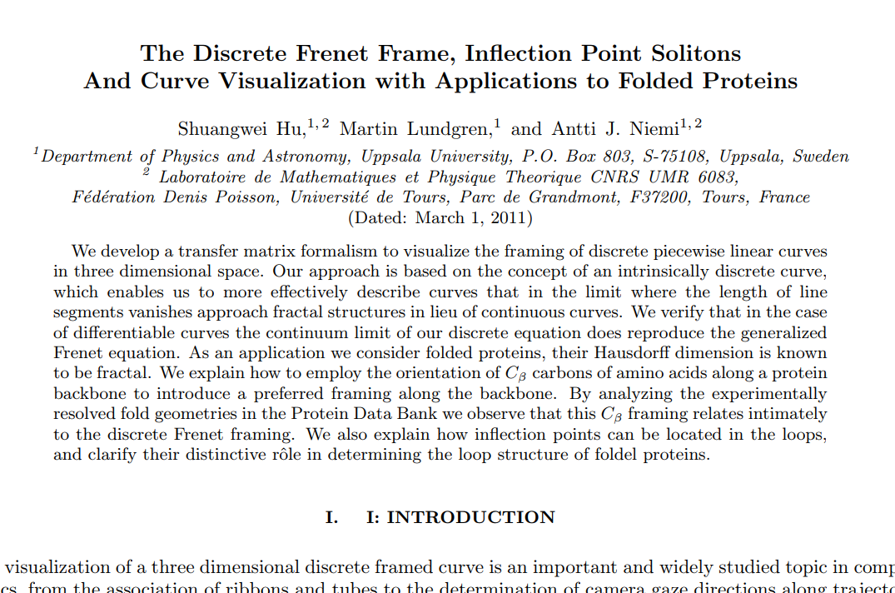
Frenet Frames in Research

Slide 4
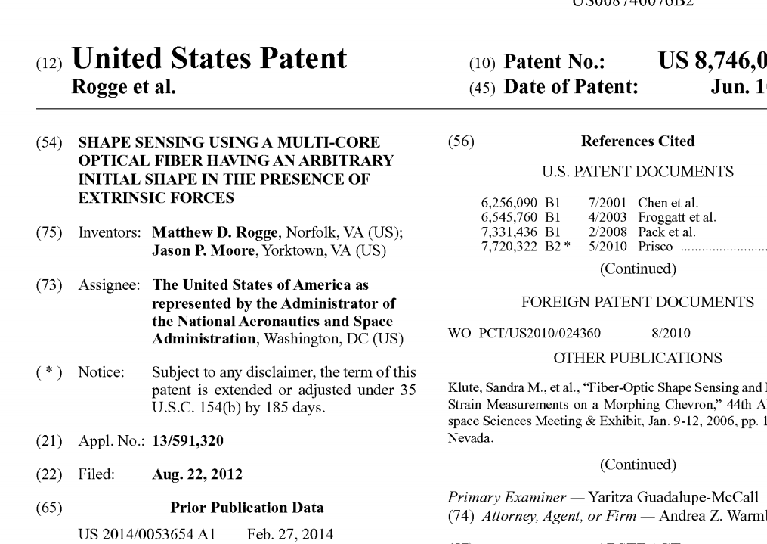
Frenet Frames in Technology

Slide 5
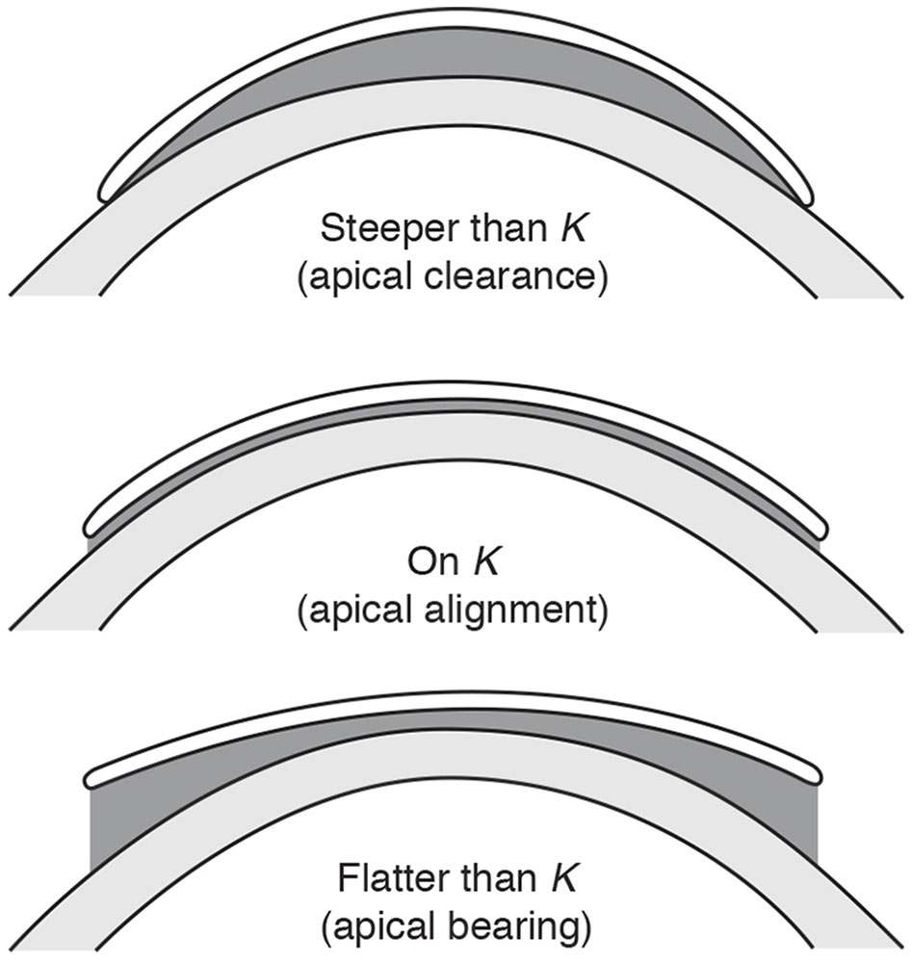
Base Curve Radius

Slide 6
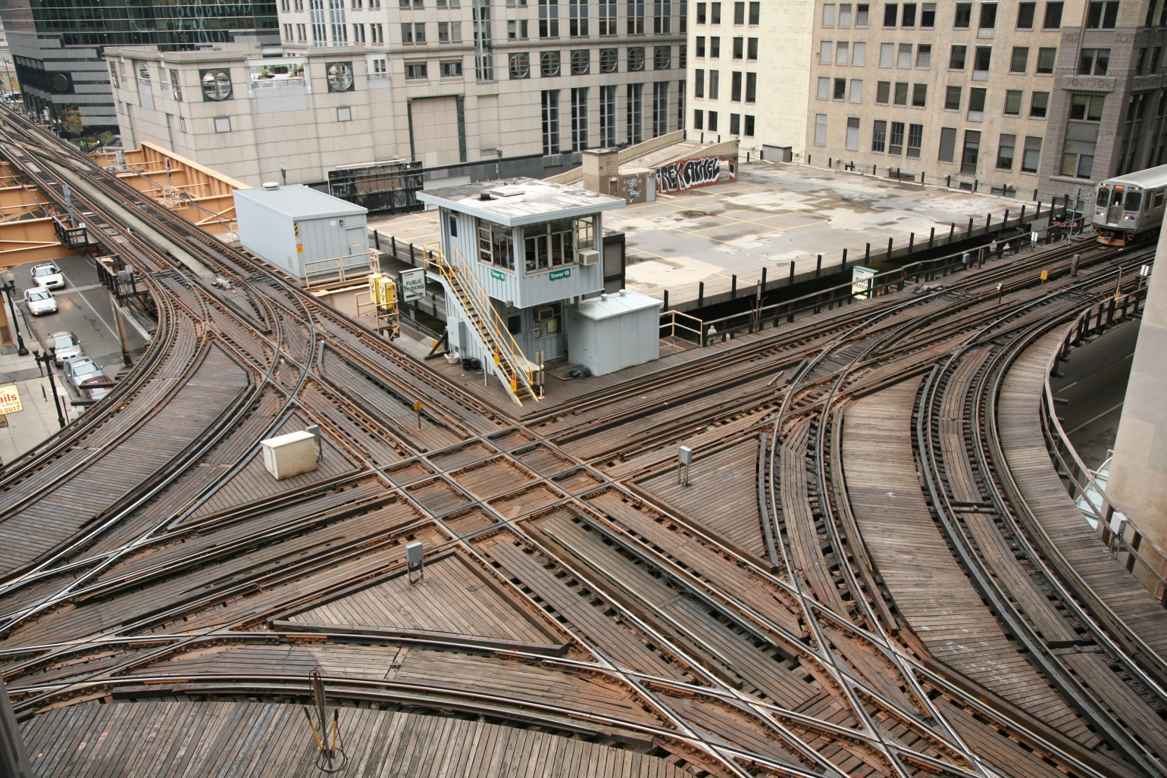
Minimum Railway Curve Radius

Slide 7
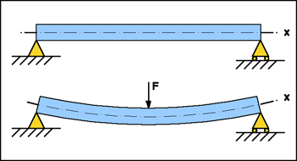

Beam Deflection

Slide 8
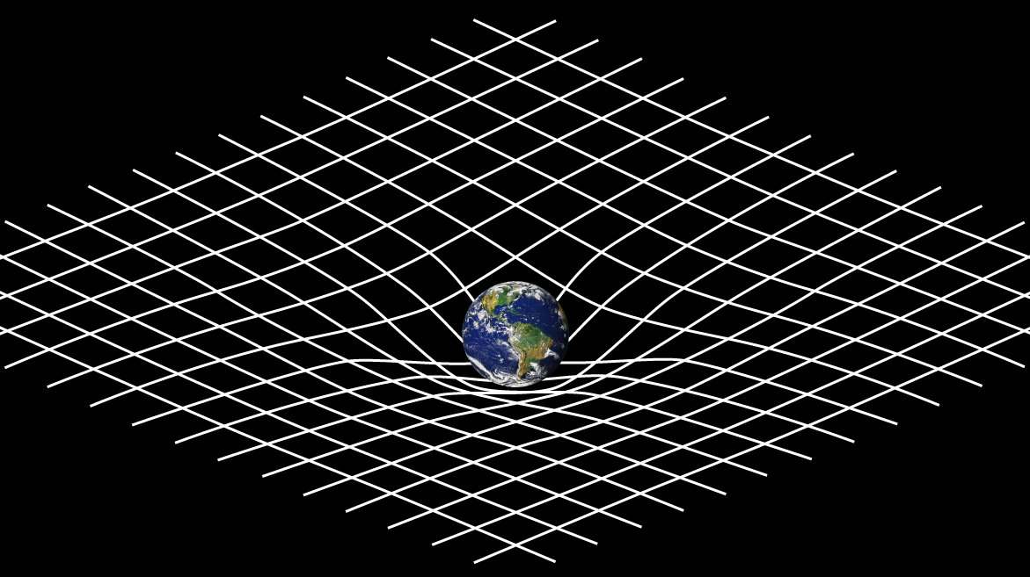
General Relativity

Slide 9
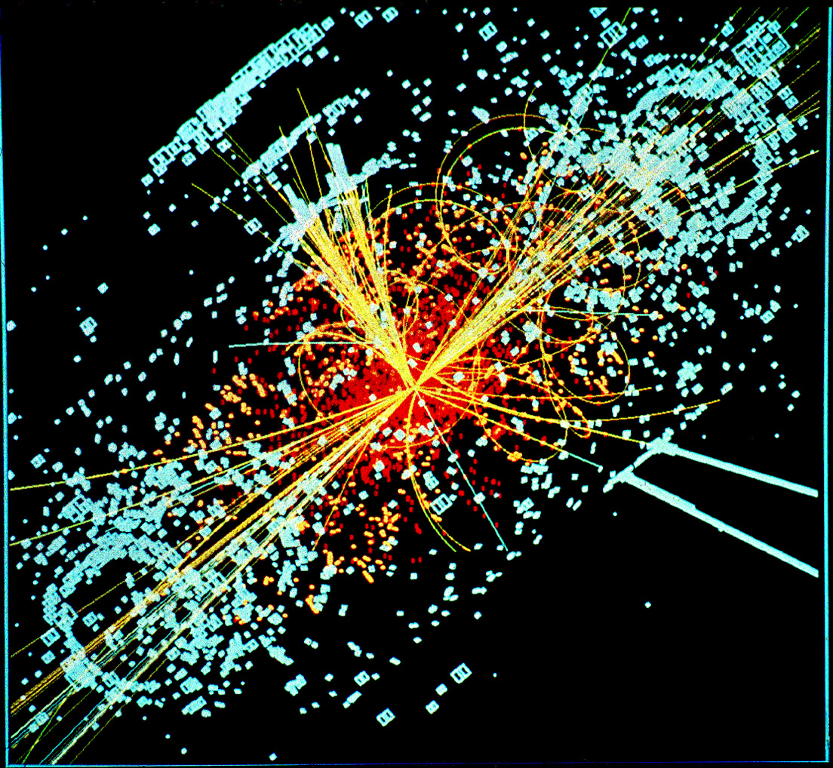
Kaluza-Klein Theory

Slide 10

String Theory

